Slide 1
Argument Essay
1

Slide 2
Argument Essay
The argumentative essay is a genre of essay writing whose purpose is to argue a position.
It requires the writer to investigate a topic, collect, generate, and evaluate evidence, and establish a position on the topic in a concise manner.
Argumentative essay assignments generally call for extensive research of literature or previously published material.

Slide 3
Expository Essay vs. Argument Essay
An expository essay “exposes” information about a subject to educate an audience. Some keywords and phrases that give clues that an assignment is asking for expository writing include:
“Cause and effect”
“Explain how”
“Define and explore”
“Compare and contrast”

Slide 4
Expository Essay
Characteristics
  Logical
  Analytical
  Unbiased
  Explanatory
Importance
  The value of understanding a subject and being able to explain it to others.
  How to explain concepts clearly and objectively.
  How to dissect evidence to determine its validity.

Slide 5
Expository Essay vs. Argument Essay
These two genres are similar, but the argumentative essay differs from the expository essay in the amount of pre-writing (invention) and research involved.
Argumentative essays generally call for extensive research of literature or previously published material.
Detailed research allows the student to learn about the topic and to understand different viewpoints regarding the topic so that s/he may choose a position and support it with the evidence collected during research.

Slide 6
Questions to ask in topic-choosing
Does the topic have two (or more) viewpoints? A topic without at least two viewpoints is not suitable.
How much do you know about the topic? You’d better choose a topic you feel passionate about. Do you need to learn more about the topic? What is your opinion on the topic?

Slide 7
Brainstorming supporting ideas with pro-con chart
Thesis Statement: Adults should be required to pass a comprehensive test before they can become parents.
Pro | Con

Slide 8
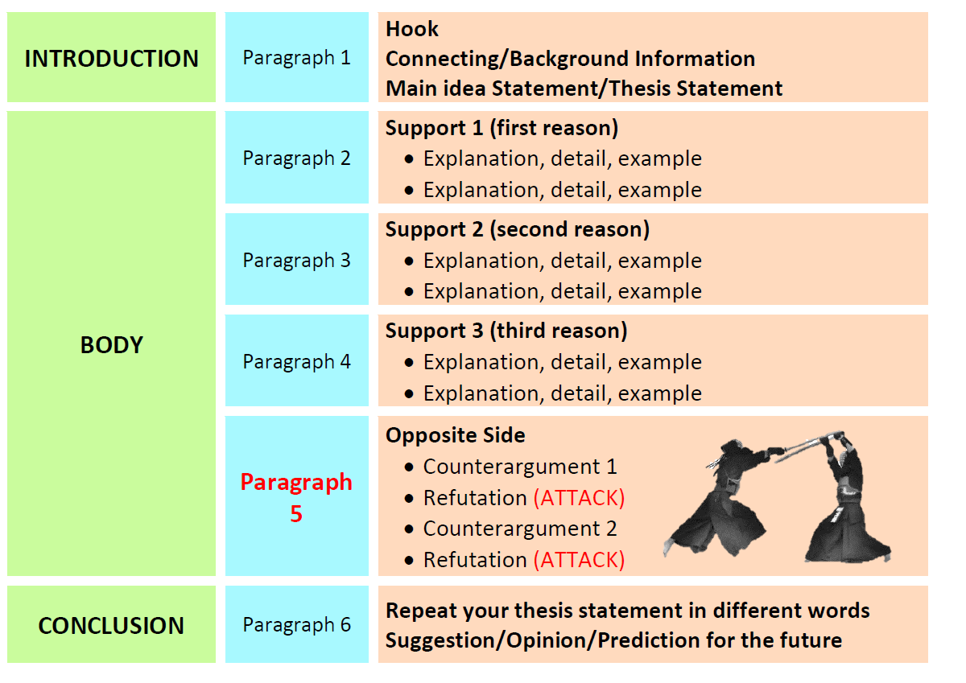
Typical Structure

Slide 9
INTRODUCTION | Paragraph 1 | Hook Connecting Information Thesis Statement (Include supporting details)
BODY | Paragraph 2 | Support 1: Recycling saves energy Creating glass from recycled glass uses 50 percent less energy than making new glass. Recycling one soda can saves enough energy to run a TV for three hours.
 | Paragraph 3 | Support 2: Recycling reduces air pollution Using recycled products help reduce the amount of pollution in our air
 | Paragraph 4 | Opposing viewpoint(s) Counterargument: One person cannot make a difference. Refutation: Each person produces 1,600 pounds of waste each year, but as much as 1,100 pounds of that total could be recycled.
CONCLUSION | Paragraph 5 | Restate thesis (Summarize the key points discussed in the body paragraphs) Suggestions/ opinion/ prediction

Slide 10
More about Structure
A clear, concise, and defined thesis statement that occurs in the first paragraph of the essay.
Clear and logical transitions between the introduction, body, and conclusion.
Body paragraphs that include evidential support + warrant.
Evidential support (whether factual, logical, statistical, or anecdotal).
A conclusion that does not simply restate the thesis, but readdresses it in light of the evidence provided.

Slide 11

Counterargument
Your job is to make the reader agree with your opinion about a controversial topic. You have to (1) state your opinion, (2) give reasons to support your opinion, and (3) argue against the opposite opinion. Overall, you must convince the audience that your side of the argument is correct. To convince the audience, your essay must be balanced—it must include your viewpoint and the opposing viewpoint, or counterargument.
Even though you are arguing only one side of an issue, you must think about what the other side would say about your opinion. After you give the counterargument, you must refute it by showing that it is wrong. If your essay is balanced, a reader is more likely to agree with you.

Slide 12
Thesis statement: Americans should vote for Kamala Harris in the 2028 presidential election.
Counterargument: Some people may argue that Kamala Harris’s leadership style raises concerns about her ability to unify the country and effectively address pressing issues. For example, her work on immigration and voting rights has been perceived by some as lacking tangible progress.
Refutation: While it’s true that Kamala Harris has faced challenges in her political career, it is important to recognize the structural and systemic barriers that have limited her ability to achieve sweeping progress, especially in highly contentious areas like immigration and voting rights. These issues often require congressional cooperation, which has been notoriously difficult to secure in a divided government.

Slide 13
References
https://www.studysmarter.co.uk/explanations/english/essay-prompts/expository-essay/
https://www.matthewbarbee.com/uploads/1/6/8/9/16895428/argumentative_essay_worksheets_5.pdf
https://owl.purdue.edu/owl/general_writing/academic_writing/essay_writing/argumentative_essays.html

